Slide 1
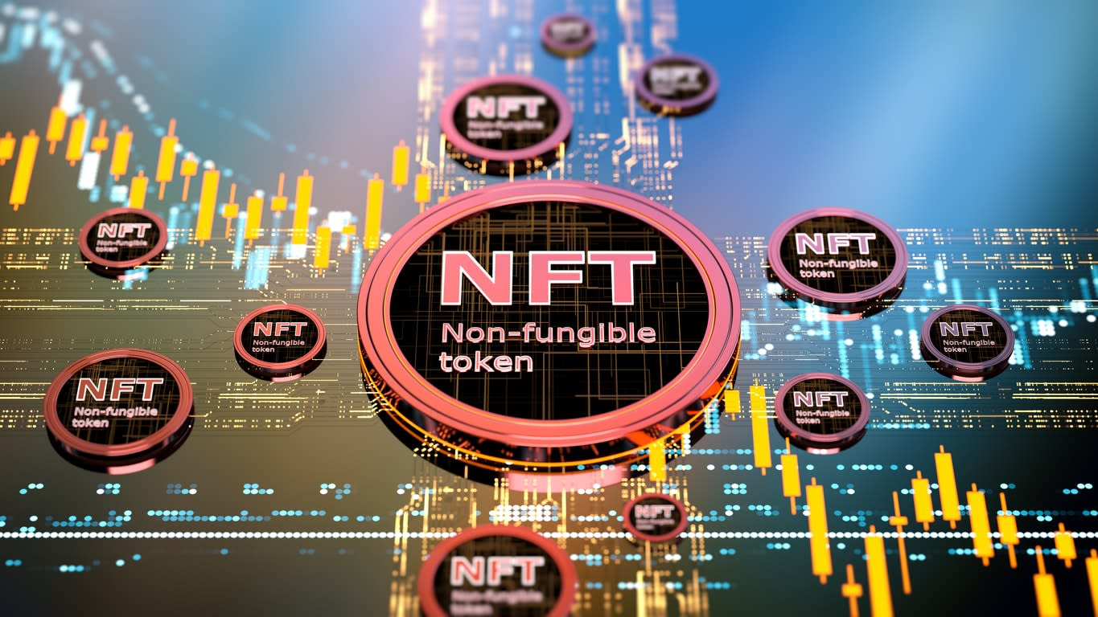
Project 3 ​
Non Fungible Token Marketplace​
Ashweej Shenoy​
Bailey Carlson​
Jordan Candido​
Lucas Nardy​
Wesley Osborne

Slide 2
Agenda
Technologies Used
Images, MetaData, NFT Contract
React Website
NFT Market Place

Slide 3
Technologies Used
Solidity​
React​
Node.js​
ethers​
hardhat​
@nomiclabs/hardhat-waffle​
ethereum-waffle chai
@nomiclabs/hardhat-ethers​​
web3modal​​
@openzeppelin/contracts​​
ipfs-http-client​​
axios​​
Javascript​​
HTML & CSS

Slide 4


Slide 5
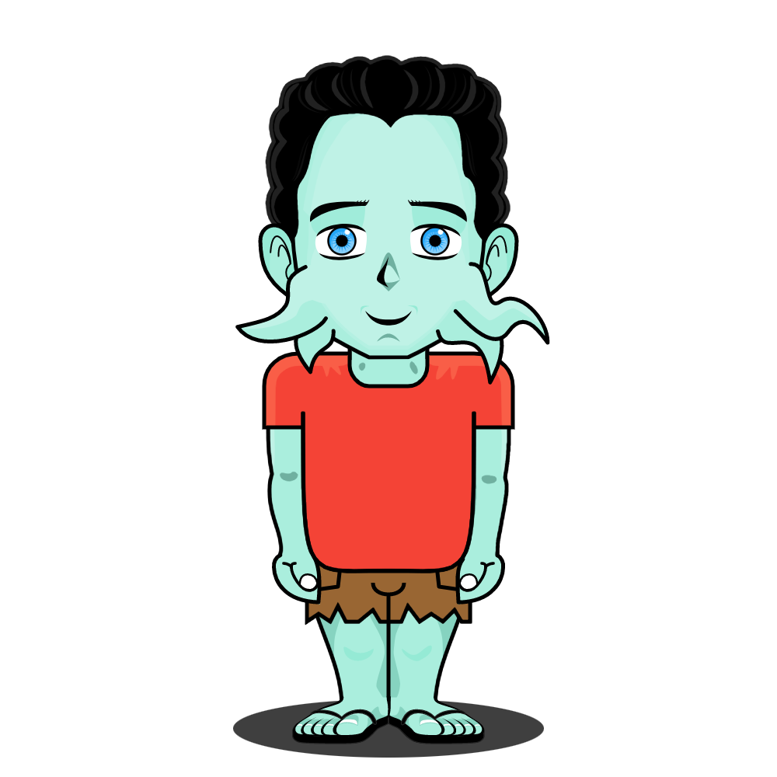
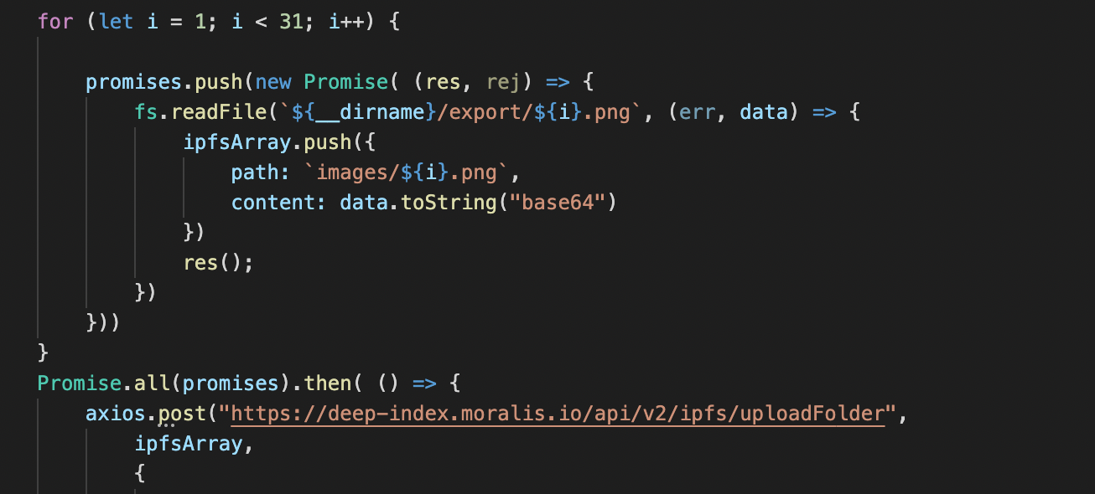

Images
Step 1. Create images
Step 2. Add all image to one folder
Step 3. Upload the images

Slide 6


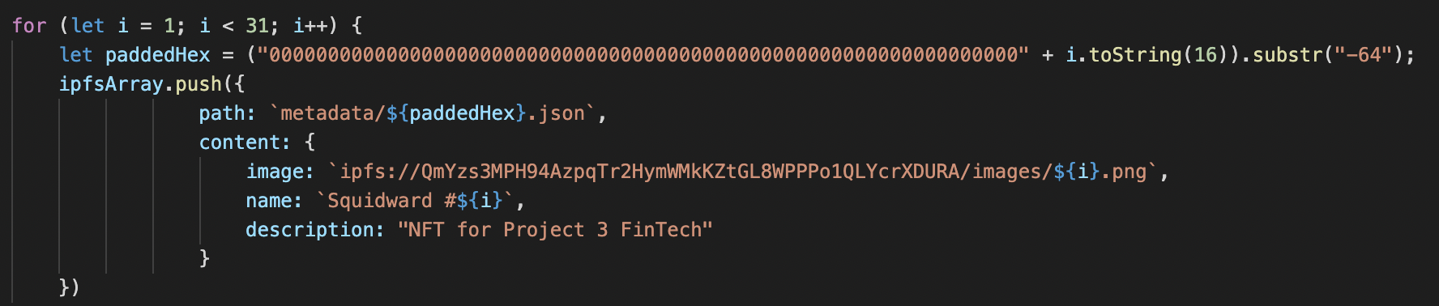
Metadata
Step 4. Create the metadata 64 alphanumeric code
-ipfs storage online

Slide 7

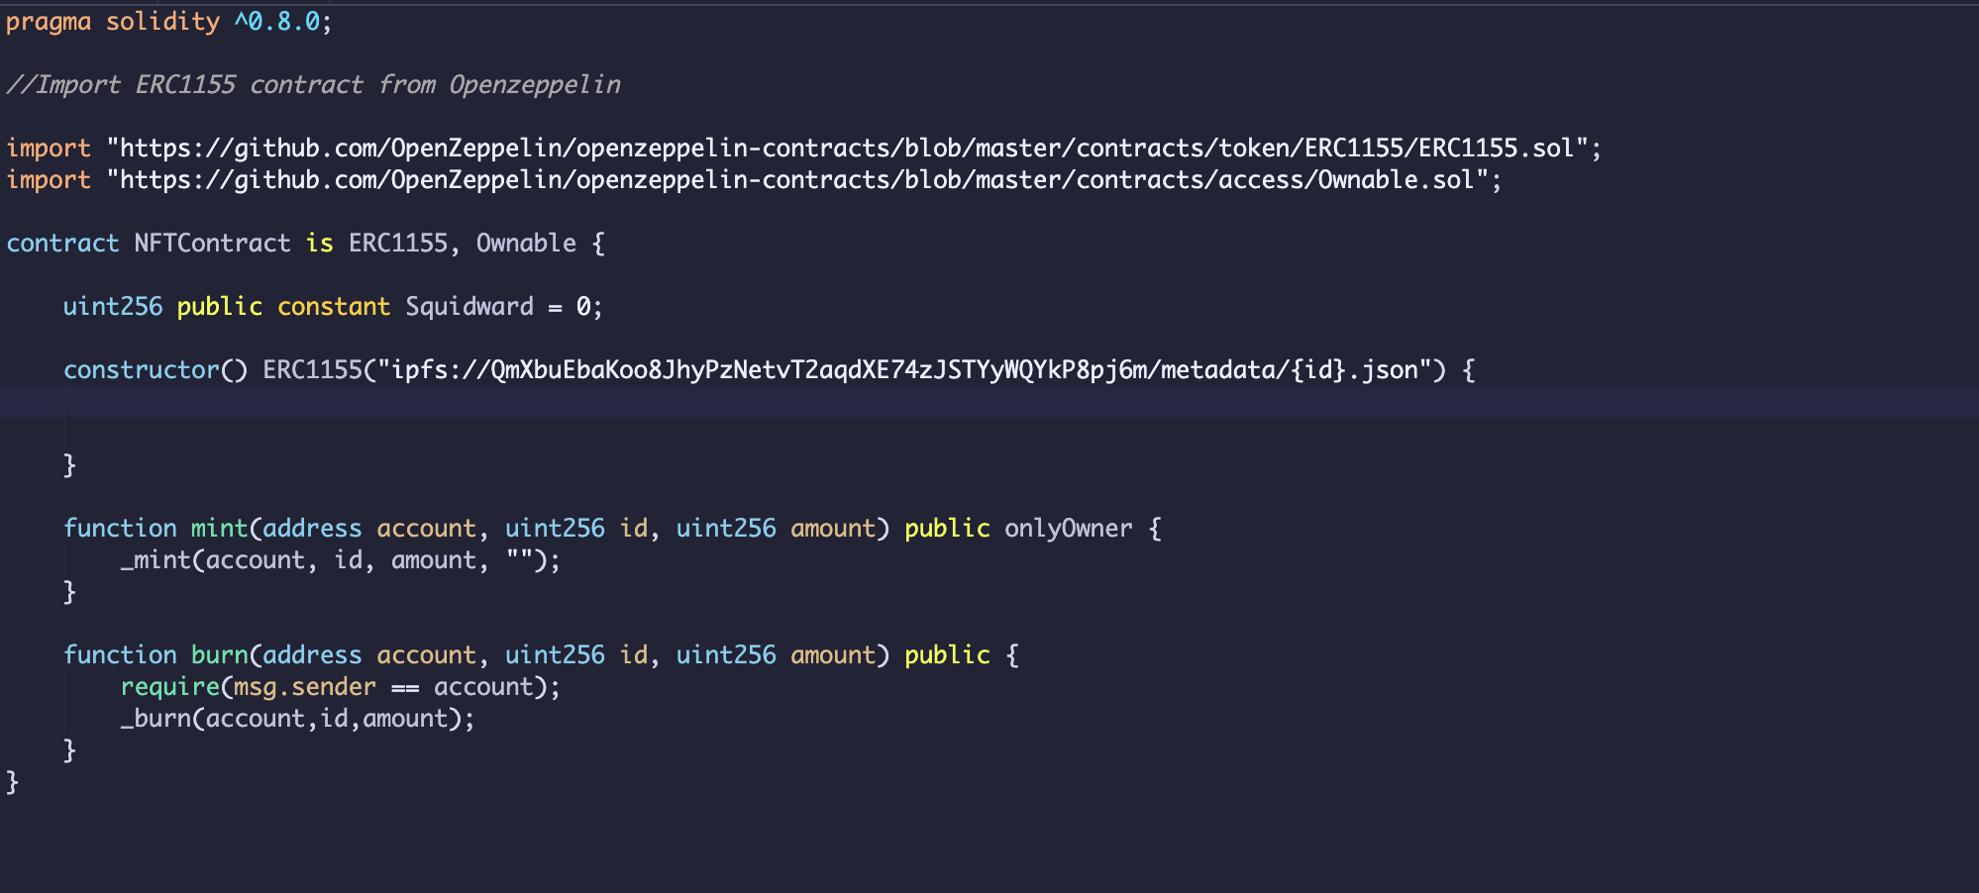
NFT Contract
Step 5. Create contract on solidity
connect to IPFS

Slide 8
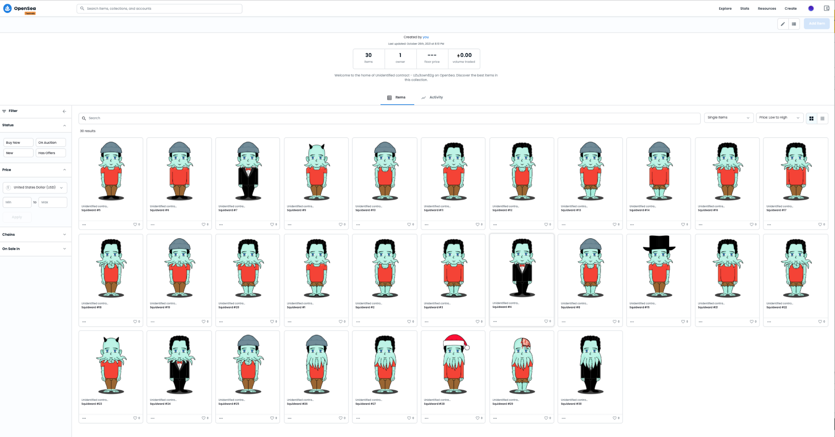

Slide 9
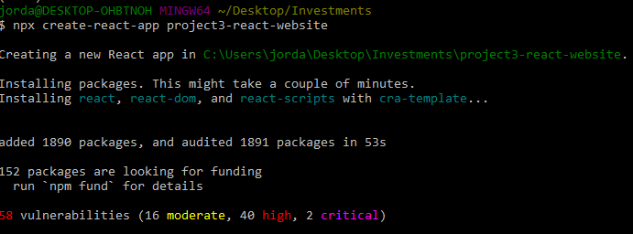
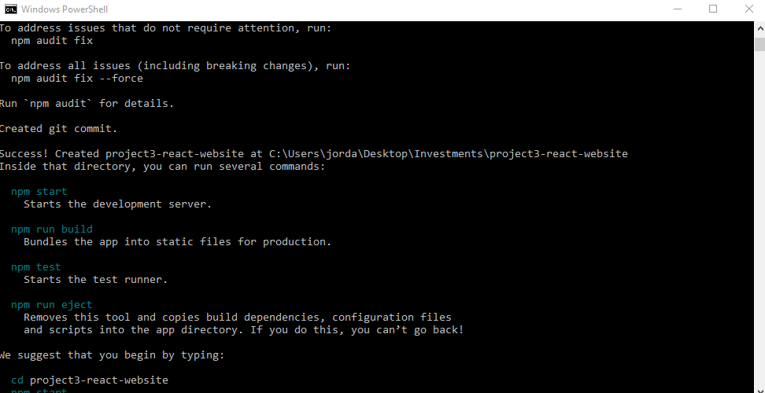
React Website Setup

Slide 10
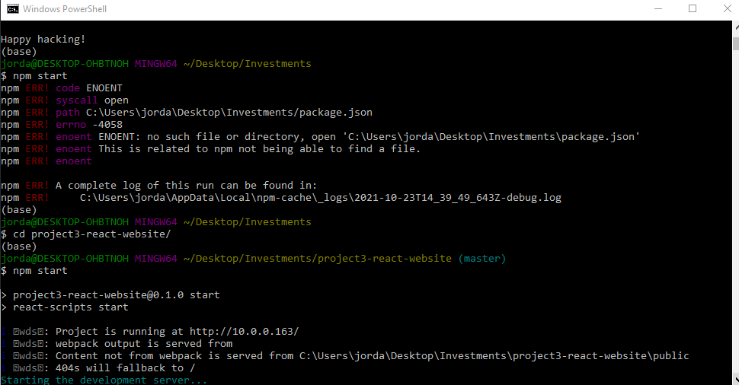
React Errors and Regrets

Slide 11
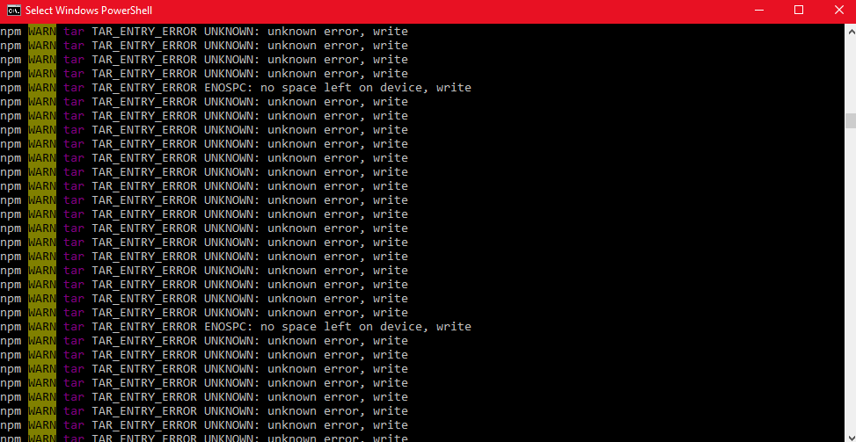
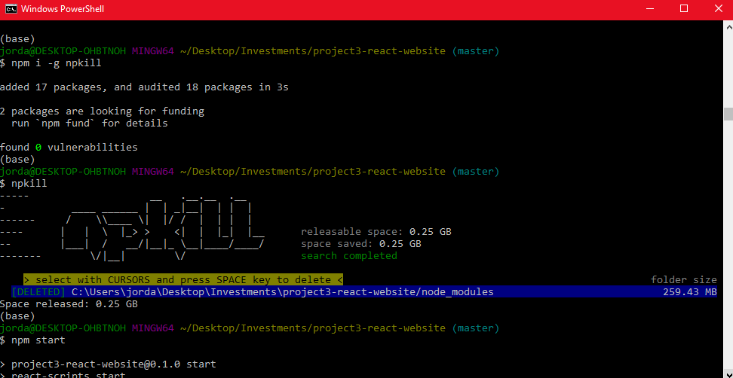
React Errors and Regrets

Slide 12
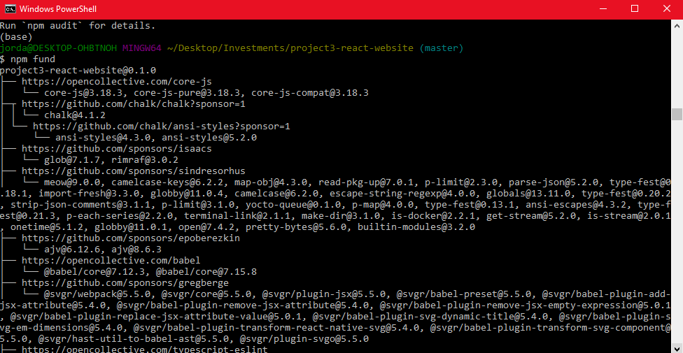
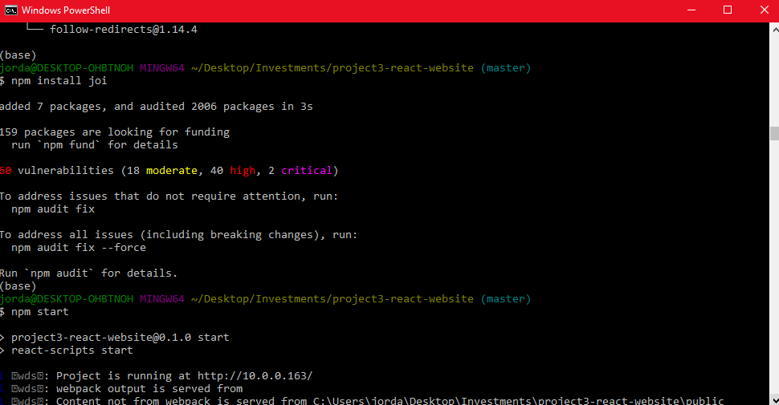
React Website Additional Installations

Slide 13
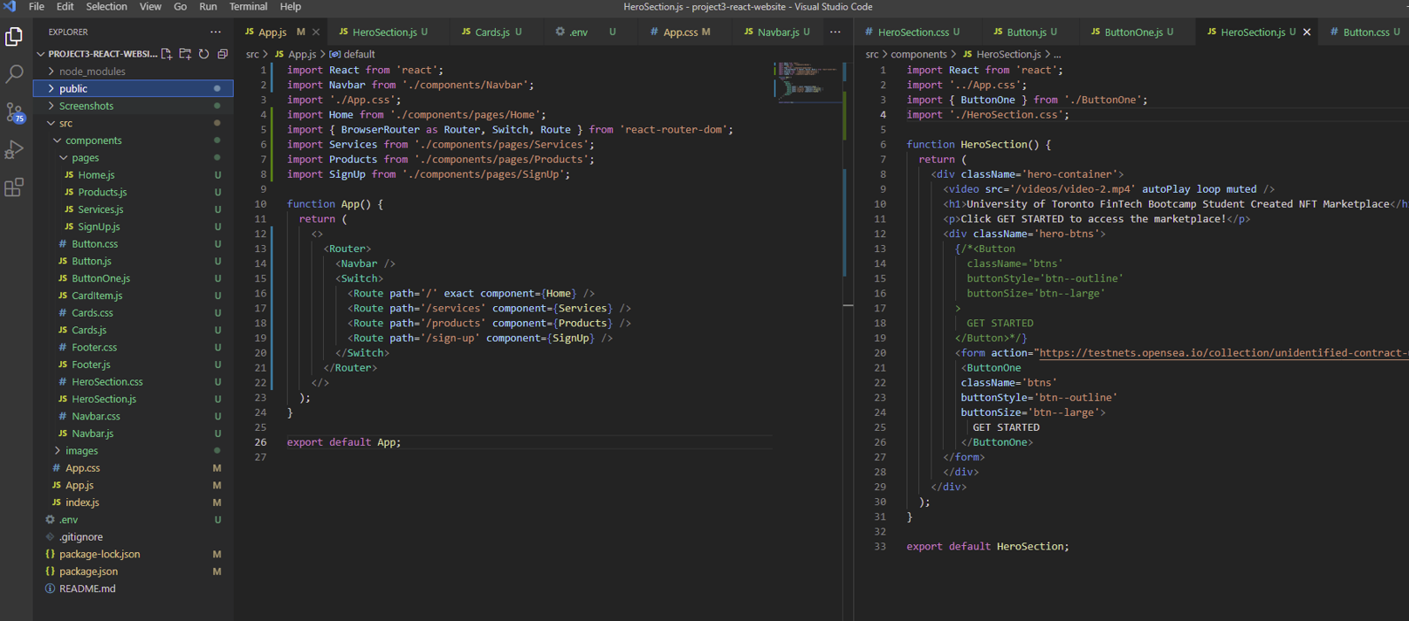
HTML & Javascript Coding

Slide 14
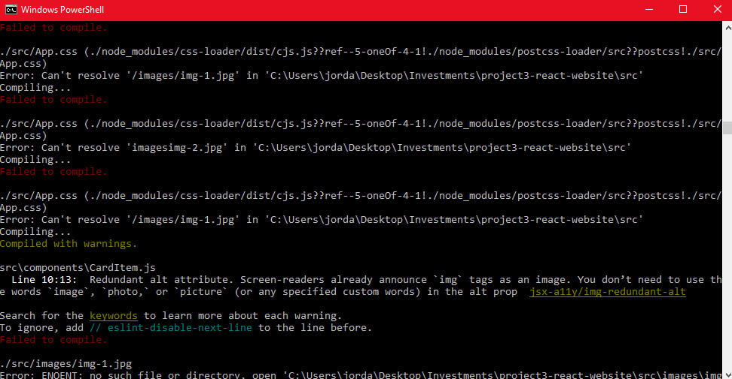
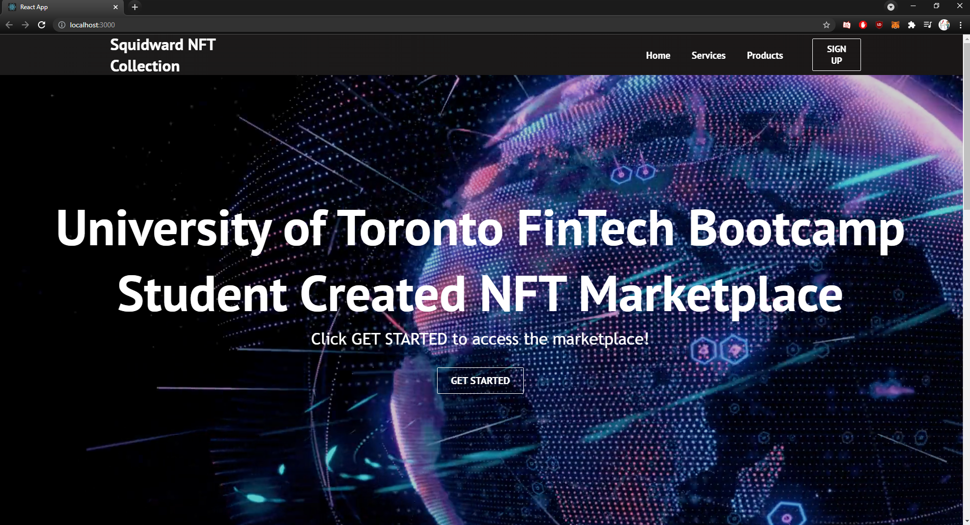
Website Demo & Next Steps

Slide 15
NFT Marketplace -Smart Contract
Core libraries used
Open Zepplin
ERC721
Storage
ReentryGuard
Next/React js
IPFS
Deployment technique
Netlify to deploy front end
utilize Matic test network (L2 of Eth) for blockchain deployment

Slide 16
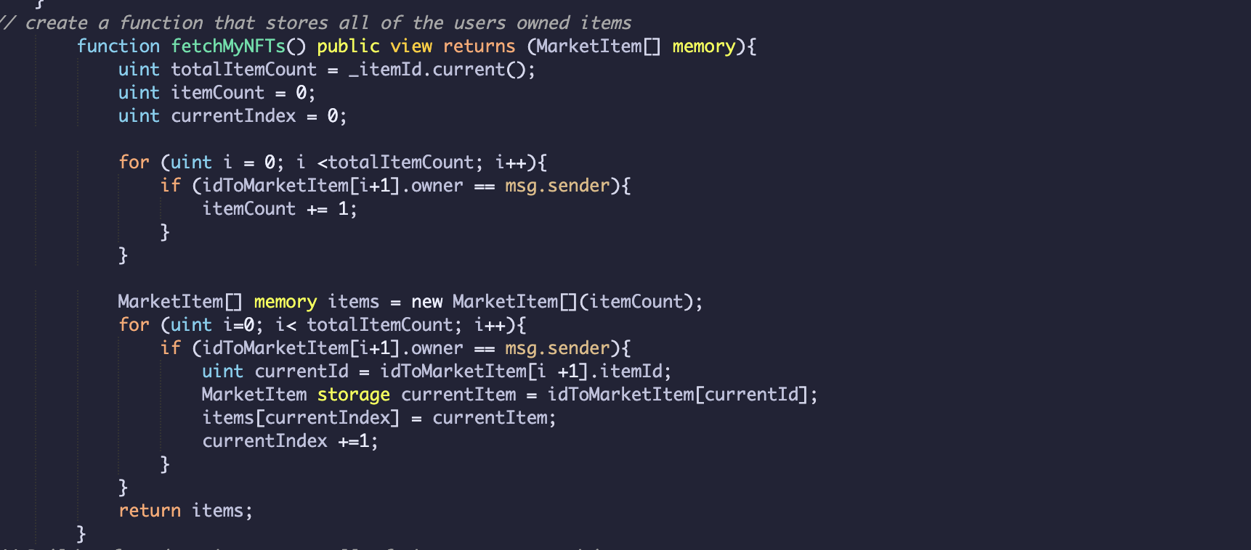
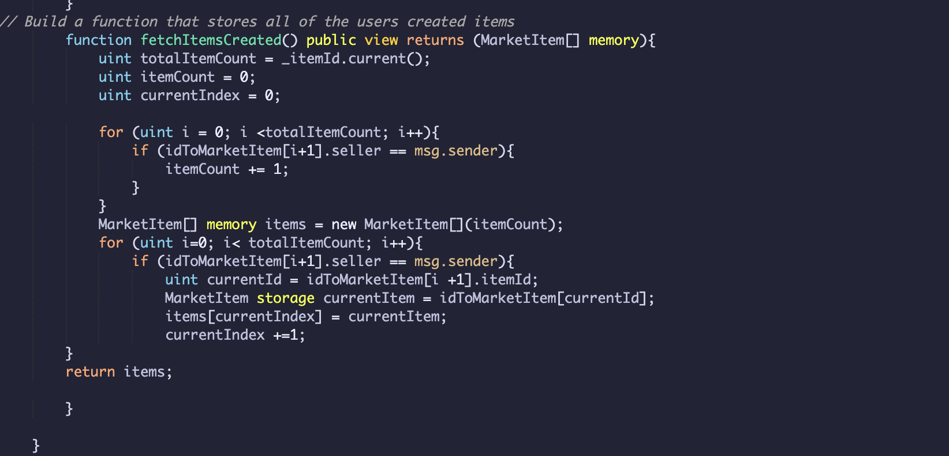
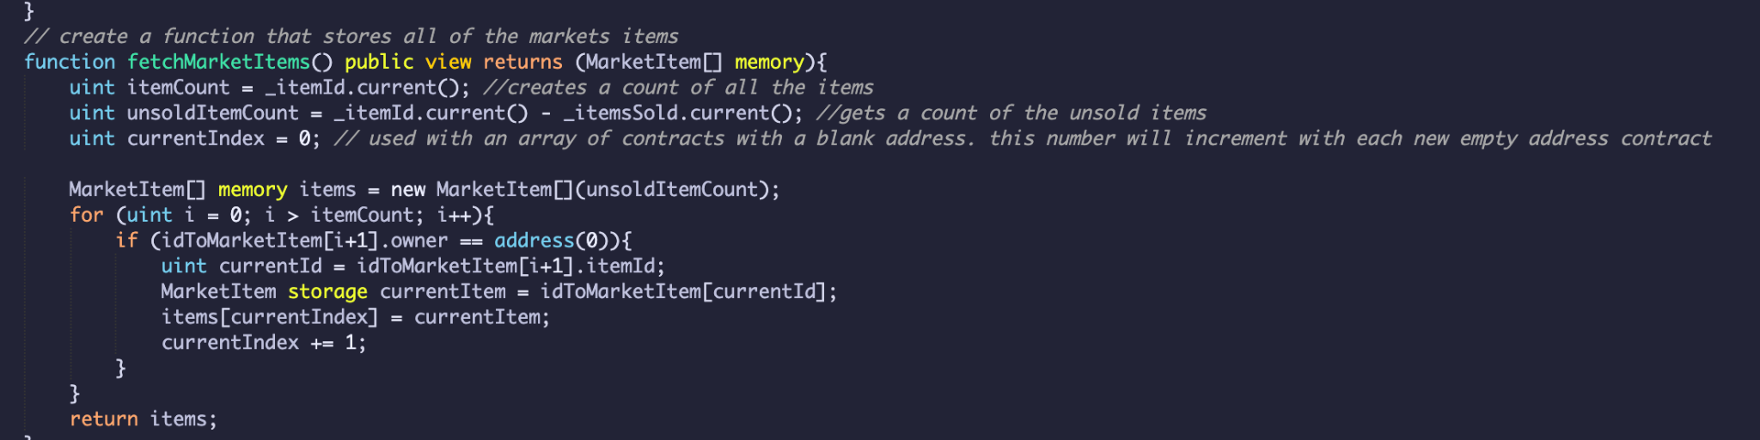
NFT Marketplace -Smart Contract

Slide 17
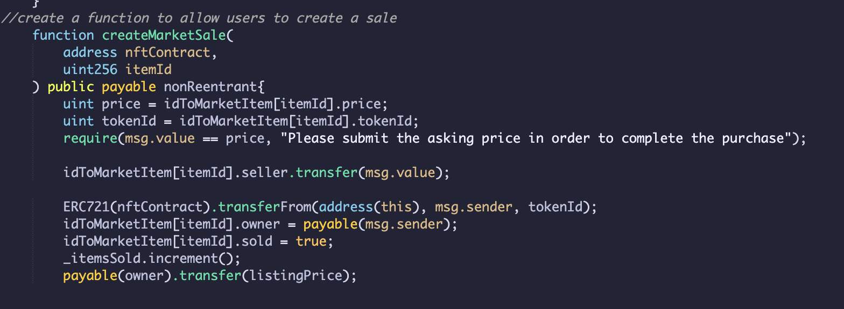
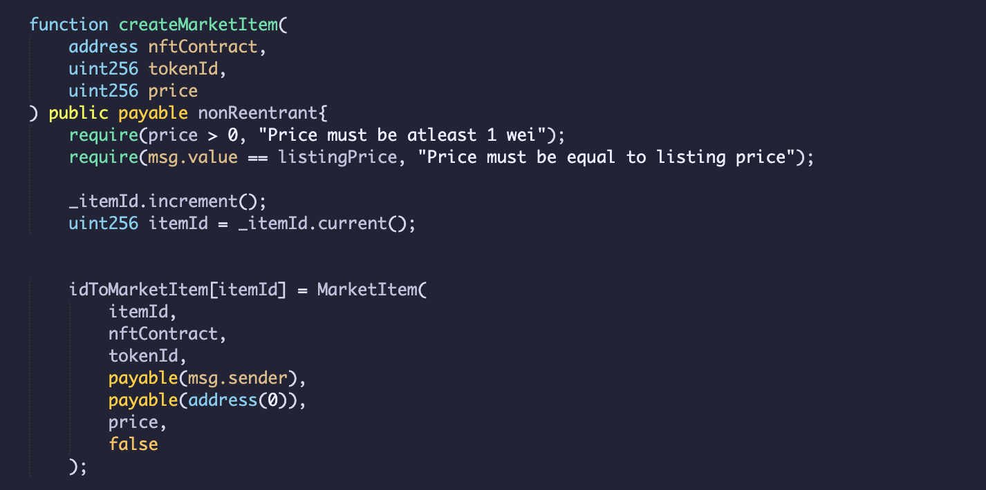
NFT Marketplace -Smart Contract

Slide 18
Thank You! Any Questions?

